Slide 1
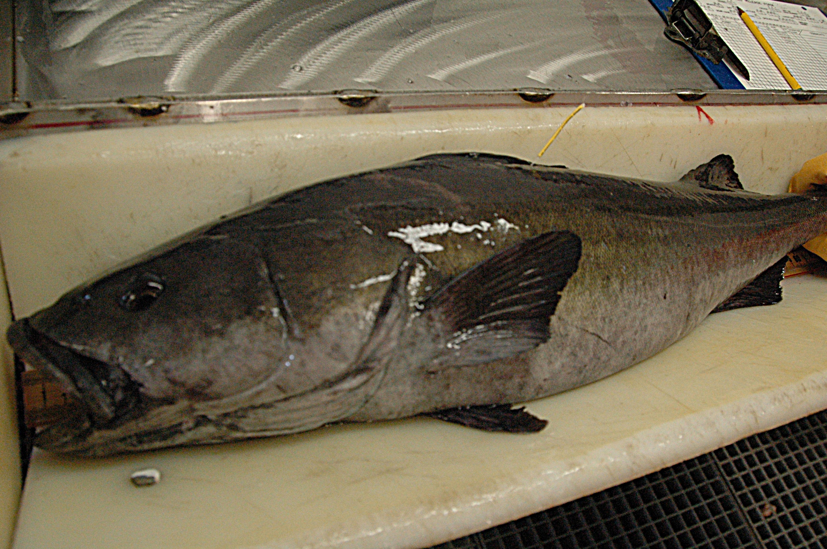
AFSC Sablefish Tag Program
Katy B. Echave
Sablefish CIE Review 2026

Slide 2
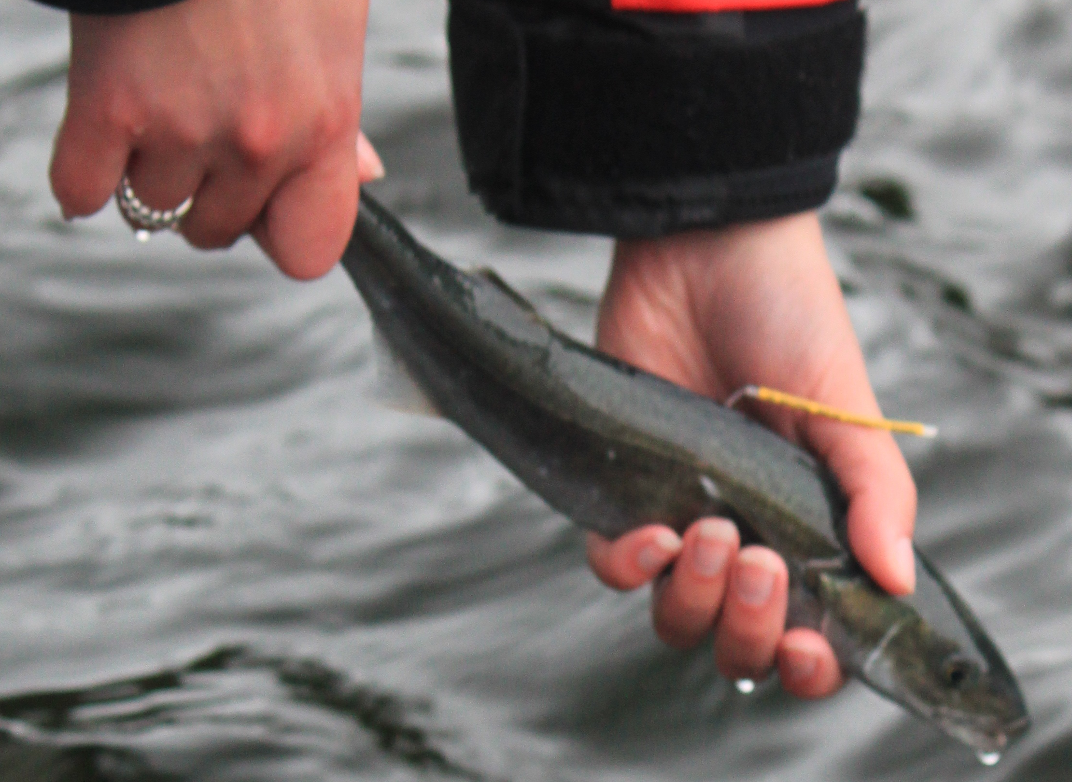
Extensive Time & Data Series
TAG RELEASE
Tagging with conventional tags since early 1970s: > 40 yrs
~413,000 TOTAL TAG RELEASES
Data: location, date, length, depth, gear

Slide 3
TAG RELEASE
~ 3,500 adult sablefish tagged/yr on the annual LL survey

Slide 4
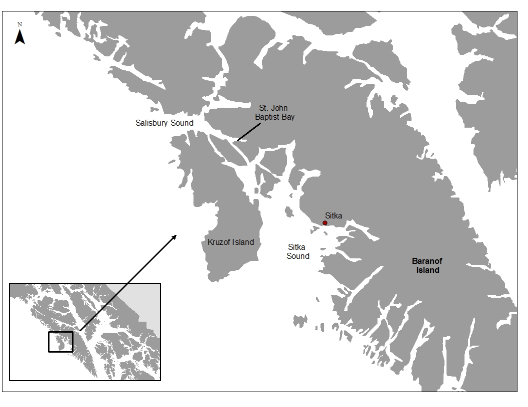
TAG RELEASE
~ 100 – 1,000 juvenile (age-1) sablefish tagged/yr on juvenile tagging cruise

Slide 5
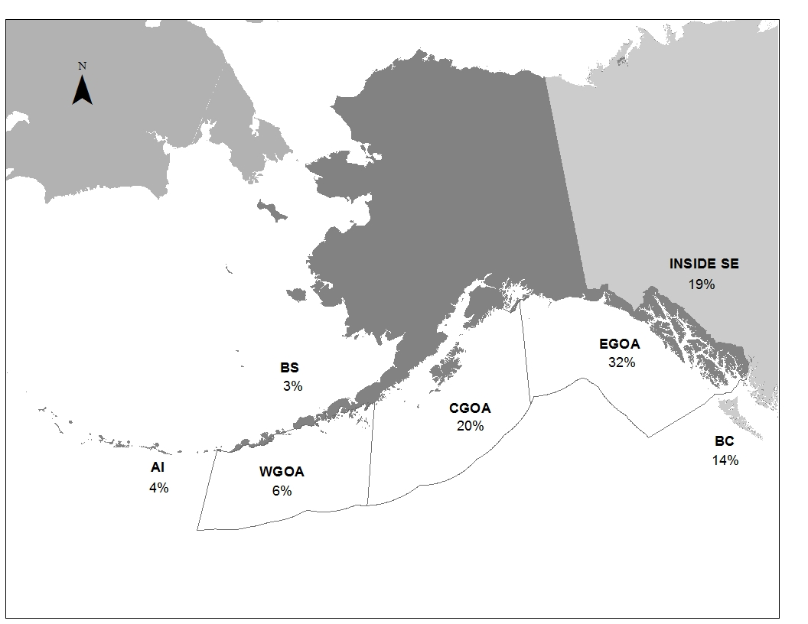
TAG RECOVERY
~38,500 TOTAL RECOVERIES
~450 – 650 NMFS tag recoveries/yr
Additional 250 BC tags recovered in AK/yr (~25% of total recoveries)

Slide 6
TAG RECOVERIES
DATA:
Release/recovery locations- great circle distance traveled
Time at liberty
Depth – @ release and capture
Size - growth
Otoliths- age

Slide 7
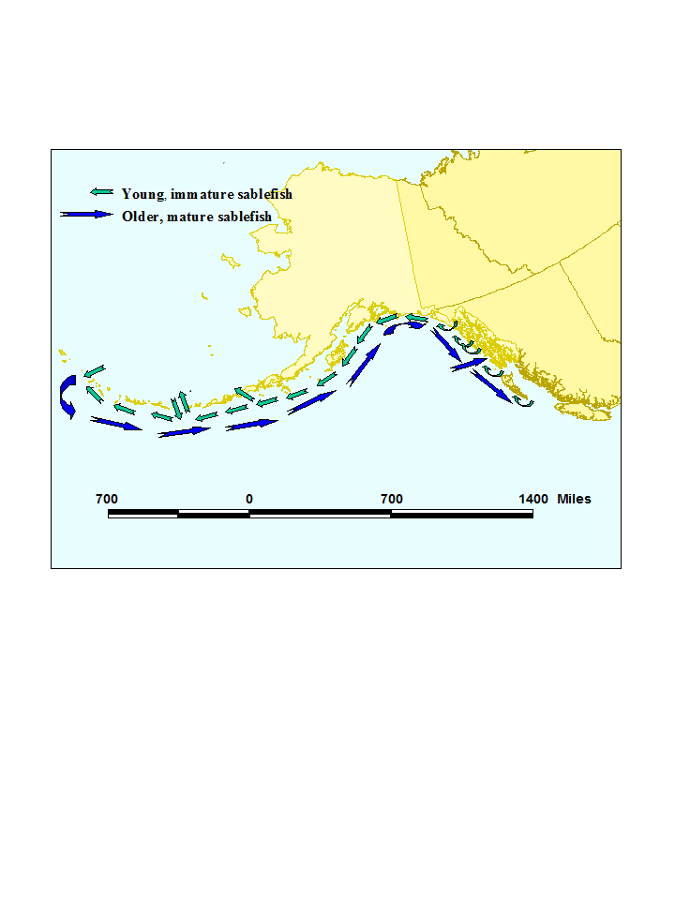
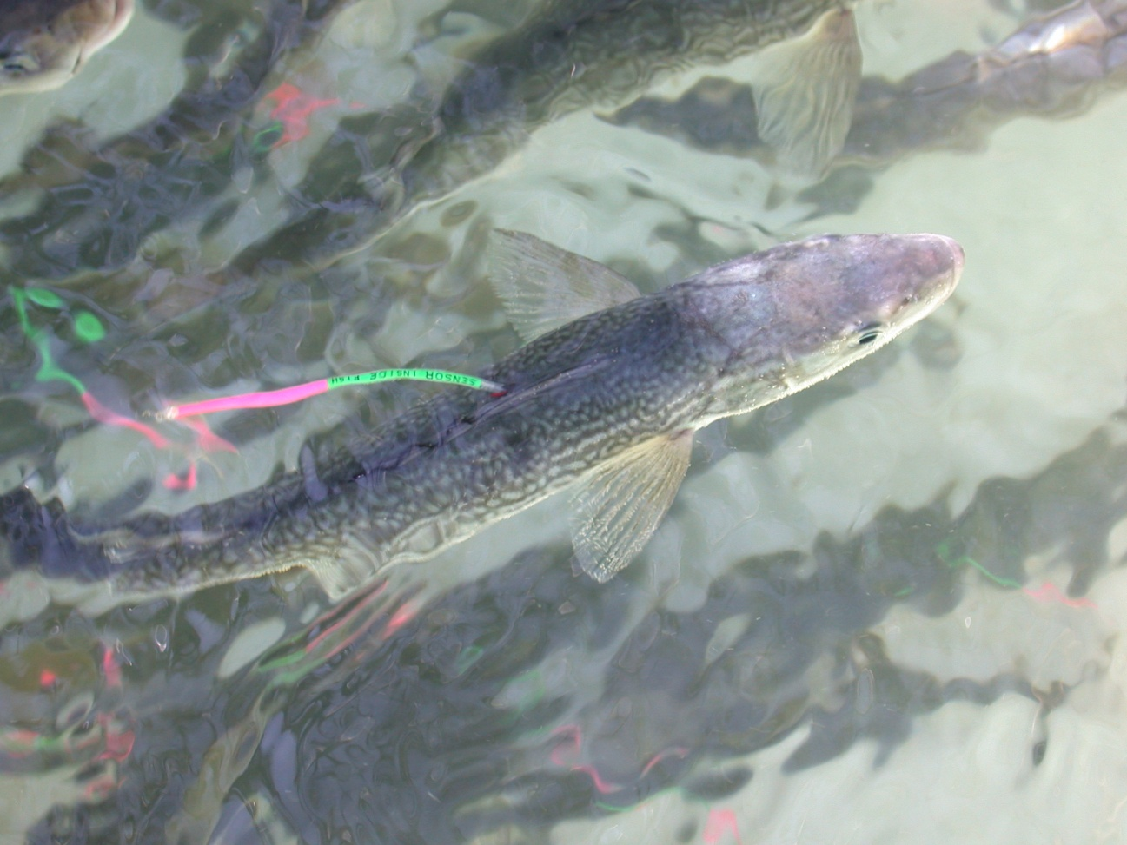
Tag Data used for:
Estimating growth
Known-age studies
Movement rates
Geographic apportionment of harvest rates
Decipher general movement patterns

Slide 8
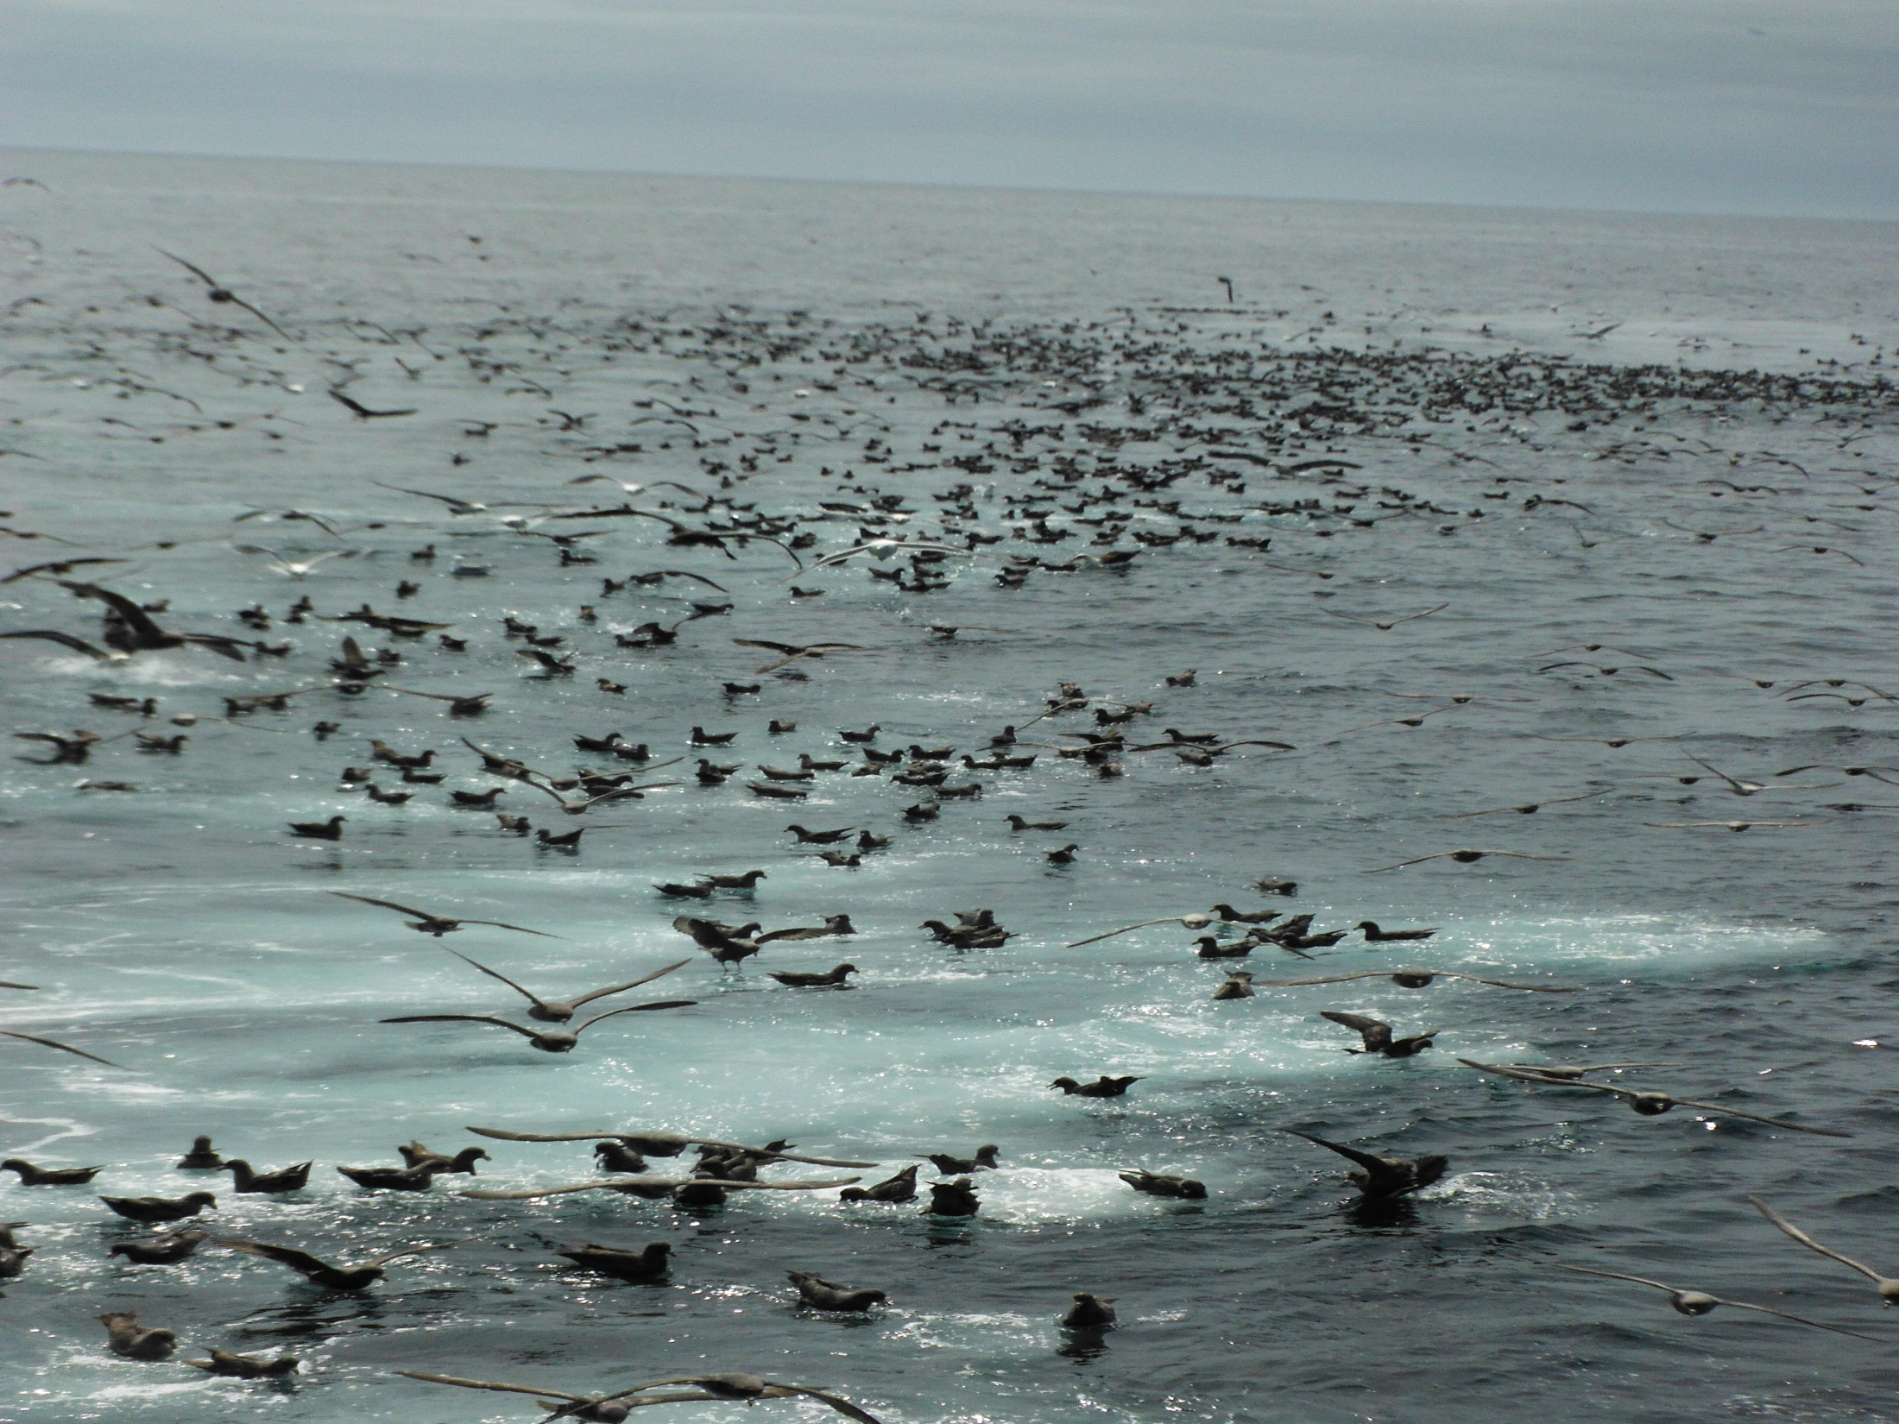
Sablefish Move….
A LOT!
Average distance of 340 nm
FAR!
Furthest recovery: 2,586 nm –
tagged off Washington and recovered in the Aleutian Islands 6 years later
QUICKLY!
Traveled 116 nm in 6 days
FOR LONG PERIODS!
Longest time at liberty >39 yrs
BUT….
We don’t know why.

Slide 9

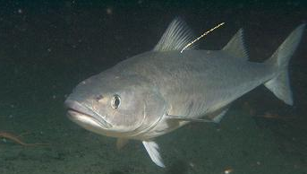
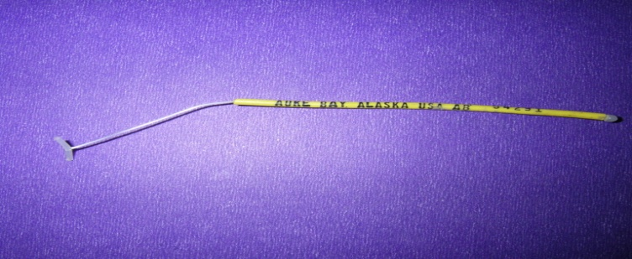
REWARD
FOR TAGGED SABLEFISH
The U.S. National Marine Fisheries Service Auke Bay Laboratory in Juneau, AK tags sablefish (blackcod) in the Gulf of Alaska, Bering Sea and Aleutian Islands in order to study distribution and migration.
Tags may be yellow, red, or orange and are usually located below the first dorsal fin on the left side of the fish. In addition, sablefish are being tagged with ¾ inch diameter x 2 ¼ inch long electronic tags placed inside the fish with a 3 inch long fluorescent green and pink tag located near the dorsal fin of the fish. The external tag reads – “Reward for Depth Sensor Inside Fish.” These electronic tags are worth monetary rewards of up to $500 if returned.
Postage-paid envelopes are available in most areas. For a reward and information on the tagged fish, please send tags with as much of the following information as possible:
Name of vessel Date of recovery
Location of recovery Sex of the fish
Fork length (from tip of snout to fork in tail) Round weight
Depth fished Type of gear
Sablefish Tag Program
NOAA/NMFS Auke Bay Laboratories
17109 Pt. Lena Loop Rd.
Juneau, AK 99801

